Slide 1
EXCS-BE-06
WIRELESS FIRE ALARM SYSTEM
Group Members :
Roll No | Name | Email ID | Mobile Number
20103B0031 | TEJAS BRID` | tejas.brid@vit.edu.in | 8369922997
20103B0049 | NAVDEEP PATIL | navdeep.patil@vit.edu.in | 8866557829
20103B0048 | SIDDHANT DETHE | siddhant.dethe@vit.edu.in | 7304203535
20103B0051 | SHREYAS TUKRUL | shreyas.tukrul@vit.edu.in | 8104099114
Under the Guidance of :
Prof. Amol Sakhalkar

Slide 2
Introduction
Fire safety is very important while building an infrastructure this has attracted many reaserchers and developers in the designing field. Traditional fire alarms are connected through wires which can cause a problem while installing and can be damaged in fires. This project challenges this problem.

Slide 3
Industry Expert with whom Project proposal is discussed
Name: Amol Sakhalkar
Designation: Guide in-charge
Email: amol.sakhalkar@vit.edu.in
Mobile number: 9820632790

Slide 4
Usefulness of the Project
Important in safety of system.
Easier installing process.
Flexible and expandable.
Remote monitorization.
Cost effective.
Failure of one node does not affect other.

Slide 5
Social impact of the Project
Improved security.
Faster response.
Property Protection.
Reduced false alarms.
Environmental impact

Slide 6
Objectives defined for the project
Enhanced safety and early detection.
Design system with redundant components and robust communication.
Allows easy expansion and scalability without requiring complete system overhaul.
Remote monitoring and alerts.

Slide 7
Resources Needed (Hardware and Software)
Software: Arduino software.
Components: Arduino Nano, NRF24LO1
Power Supply: Li ion Battery.
Testing equipments.
Emergency response plan

Slide 8

Project Cost
Components | Quantity | Cost
Arduino Nano | 5 | 1250
NRF24LO1 | 5 | 500
Small Buzzer | 5 | 75
Li ion batteries | 10 | 750
TP4051 | 1 | 45
Double Battery sockets | 5 | 150
Nano programming cable | 2 | 80
Female to female jumper wires | 25 | 200
MQ2 Smoke Sensor Module | 2 | 160
16x2 LCD Display with I2C interface – Blue | 1 | 160

Slide 9
Methodology
In this system the arduinos are connected to each other through NRF24L01.
The nodes are connected in a tree structure with one node as base node.
The connection does not break even if one of the nodes fail or gets damaged.
The system then alerts through a buzzer.

Slide 10
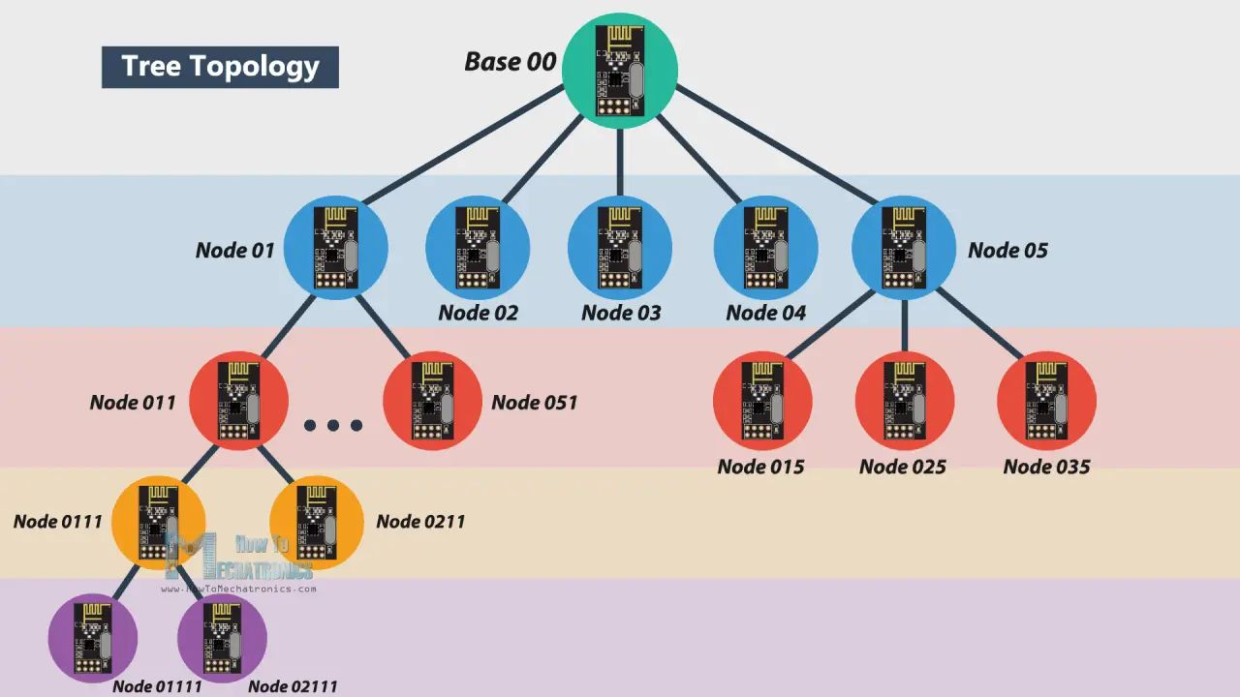
Block Diagram

Slide 11
Conclusion
📌
A wireless fire alarm system is a crucial component of modern building safety and security infrastructure. It offers numerous advantages, including rapid detection of fires, reduced installation complexity, and enhanced flexibility in system design. However, the successful implementation of such a system requires careful planning, adherence to regulations, and allocation of appropriate resources.

Slide 12
References
📖
https://howtomechatronics.com
https://www.Arduino.cc

Slide 13
THANKS!

